Slide 1
Final Presentation Name Gerrymandering Fun!
Tara Abrishami
Desh Raj
Vasileios Papaioannou
Noah Scribner

Slide 2
Gerrymandering Overview
Districts are geographical area were local, States, and Federal representatives are elected from. Gerrymandering is used when States redraw their district boundaries.
It is useful to thing of “districting a State” as partitioning a state into smaller geographical areas. There are three main rules that district:
Districts must be compact.
Each district must contain approximately the same number of people.
Districts must be contiguous.
There are two main reasons why a State HAS to redraw their district boundaries:
A State loses or gains a representative in the House of Representatives
To correct changes in population over time (usually following a Federal Census)

Slide 3
Gerrymandering Overview
There is no federal law stating the method for how States can draw their districts. In most States, the elected politicians retain the power to draw the district boundaries. This leads to gerrymandering.
Gerrymandering is the practice of manipulating district boundaries to provide an advantage to a political party or a specific group.
There are different reasons why politicians manipulate district boundaries besides party affiliations.
It is important to know that Gerrymandering to favor or disfavor a group based on race, religion, or other protected status is illegal. However, gerrymandering to favor a political party is legal.

Slide 4
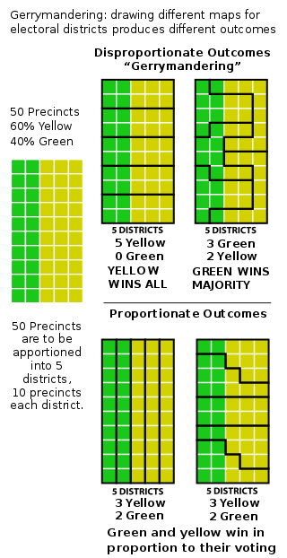
Gerrymandering Overview
Most would agree that these are “unfair” results
Most would agree that these are “fair” results

Slide 5
Relevance of Study
In 2020, the US will conduct a census of its population and in the subsequent years, nearly every States will redraw their district boundaries based on population changes.
It is critical in a democracy that people have a “fair” election that is not skewed to favor one group over another. Studying district maps and determining if they are “fair” enables the People to hold their elected officials accountable.

Slide 6
Our Goals
Develop tools and methods to evaluate State’s current and proposed district for “fairness”
We will evaluate a State’s current district map using the tools we developed
We will use Bayesian methods to create a large samples of potential district maps and evaluate the current Ohio district map
CRITICAL NOTE: There is no legal definition of what “fair” is. Each individual/group has their own view of what the concept of “fair” is. We will do our best to simply show our results without polictical bias

Slide 7
Methods
STEP 1: Initialization of a potential district map:
We set all of the possible precincts into a dictionary and then partition them into the required number of districts. At this stage we allow no constraints on the precincts into the districts. However, by using a completely random method to assign precincts into districts, we have created Boundary Conflicts.
We define a boundary conflict as: if there are two adjacent precincts, but who are in different districts. Initially there will be an extremely high number of boundary conflicts. We then use a function that will randomly select on boundary conflict. Once this boundary conflict has been identified, we established a function that will move one precinct to the other district with equal probability of which precinct is moved. We call this function our Boundary Conflict Function, BCF.

Slide 8
Methods: BCF
Here is an overview of how the BCF works:
Precincts U and V are geographically adjacent to one another (as annotated by the black line). We will either add precinct V to District Green or add precinct U to District Blue.
P(U moves to District Blue) = P(V moves to District Green) = 0.5
Let’s assume that precinct V moves to District Green.
District Green
District Blue
U
V

Slide 9
Methods: BCF
Now both precincts U and V are in the same district, and we have eliminated a boundary conflict.
After we resolve one boundary conflict, we then choose (again, at random) another boundary conflict and repeat the process. By repeating the BCF over and over again, we will eliminate with an extremely high probability district maps that fail the contiguous rule.
District Blue
U
District Green
V
W

Slide 10
Methods: BCF
The more we run our BCF, the higher our probability of reducing contiguity errors. After running this step for thousands and thousands of times, we now have created a district map that satisfies the contiguous rule. We also implemented a test to ensure that the BCF continues if we detect a violation of the contiguous rule,
There is one major problem with initializing as we do, the computational time to create a potential district map is very long. By running the BCF thousands upon thousands of times, we are spending a lot of time in simply creating potential district maps, before we even begin the analysis.
However, we believe that the overall benefit of our method more than justifies this problem. All of our district maps are indeed random. If we were to start of with some map as our initialization, we could not guarantee that we remove the bias of that map. As a potential outcome of this experiment is provide support in favor or against a certain district map, it must not have the perception of bias from the initialization.

Slide 11
Scoring
Now that we have created a district map, that satisfies our first constraint, we then begin scoring our district map. When we score a map, we evaluate it at three areas:
Population, SCOREP. How close does each of our districts come to our “ideal” population for them.
Isoperimetric, SCOREI. How compact the districts are to one another.
County Split , SCOREC. How many counties are divided by a certain district map.
Each district map is then given an overall score based on those three areas. The overall score is a weighted sum of each of the individual areas.
SCORE(d) = SCOREP(d)*WP + SCOREI(d)*WI + SCOREC(d)*WC
where d is any given accepted district map.

Slide 12
Scoring: Population
Now that we have created a district map, that satisfies our first constraint, we then begin scoring our district map. When we score a map, we evaluate it at three areas:
Population, SCOREP. How close does each of our districts come to our “ideal” population for them.
Isoperimetric, SCOREI. How compact the districts are to one another.
County Split , SCOREC. How many counties are divided by a certain district map.
Each district map is then given an overall score based on those three areas. The overall score is a weighted sum of each of the individual areas.
SCORE(d) = SCOREP(d)*WP + SCOREI(d)*WI + SCOREC(d)*WC
where d is any given accepted district map.

Slide 13
Scoring: Isoperimetric
Now that we have created a district map, that satisfies our first constraint, we then begin scoring our district map. When we score a map, we evaluate it at three areas:
Population, SCOREP. How close does each of our districts come to our “ideal” population for them.
Isoperimetric, SCOREI. How compact the districts are to one another.
County Split , SCOREC. How many counties are divided by a certain district map.
Each district map is then given an overall score based on those three areas. The overall score is a weighted sum of each of the individual areas.
SCORE(d) = SCOREP(d)*WP + SCOREI(d)*WI + SCOREC(d)*WC
where d is any given accepted district map.

Slide 14
Scoring: County Slip
Now that we have created a district map, that satisfies our first constraint, we then begin scoring our district map. When we score a map, we evaluate it at three areas:
Population, SCOREP. How close does each of our districts come to our “ideal” population for them.
Isoperimetric, SCOREI. How compact the districts are to one another.
County Split , SCOREC. How many counties are divided by a certain district map.
Each district map is then given an overall score based on those three areas. The overall score is a weighted sum of each of the individual areas.
SCORE(d) = SCOREP(d)*WP + SCOREI(d)*WI + SCOREC(d)*WC
where d is any given accepted district map.

Slide 15
Results

Slide 16
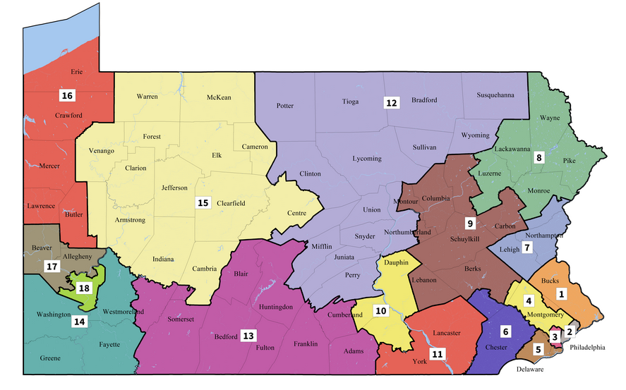

Slide 17
Cititaion
Wikipedia. Gerrymandering. https://en.wikipedia.org/wiki/Gerrymandering
http://www.publicmapping.org/what-is-redistricting

Slide 18
Questions / Comments

Slide 19
Backup Slides

